Slide 1
Variables
Python Class #2

Slide 2
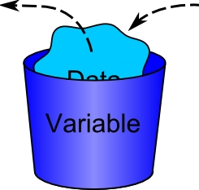
Variable, what’s that?
Container

Slide 3
Variable, why use it?
Storing
Use variable not value
Reduce number of variables

Slide 4
Common variable types
Numeral
int
float
boolean
Text
string

Slide 5
Using variables
How to name:
No capitals
score
var
Underscores
is_correct
to_output
How to define:
Classic define
var = 1
str = ‘This is a string’
Multiple defining
x, y = 3, 4
m = n = False

Slide 6
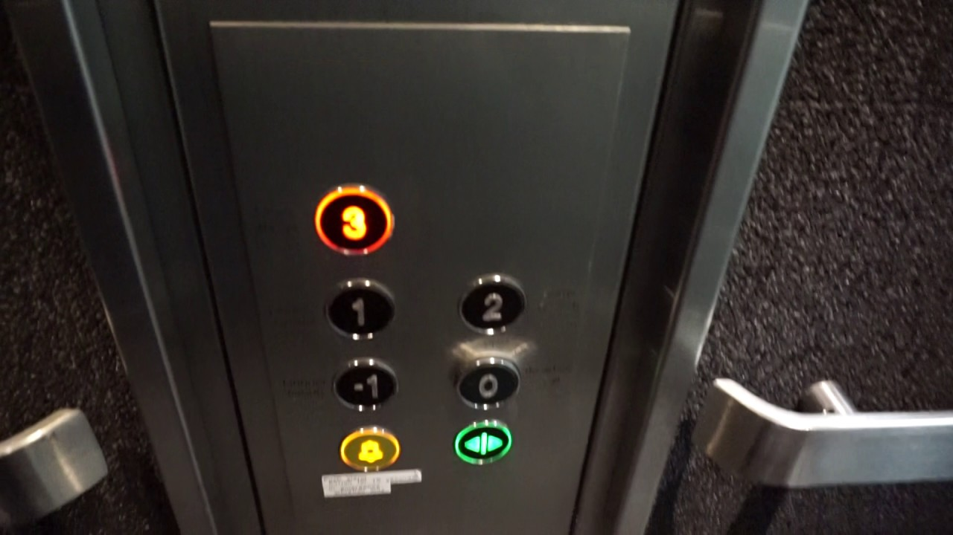
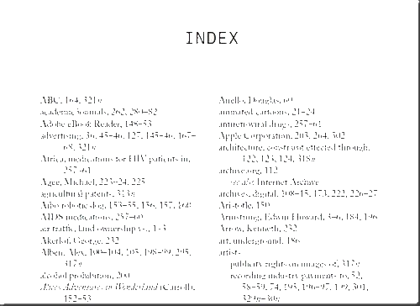
By the way, index starts at 0.

Slide 7
int variable
What is int?
A number
How to define int variable:
integer = 1234
How to change variable to int?
int()
var = int(‘416’)
Operations
+
a = b + c
−
a = b - c
×
÷
//
i = 500 // 200
%
n = 543 % 10
Methods
abs()
↑ absolute value
n = abs(-100)
Power
pow()
print(pow(5,2))
**
print(5 ** 2)
Setting value operations
+=
add += 1
-=
lose -= 1
*=
twice *= 2
/=
result /= 3
%=
getMode %= 99

Slide 8
float variable
What is float?
A decimal number
How to define float variable:
fl = 12.34
How to change variable to float?
float()
var = float(‘416’)
Operations
+
a = b + c
−
a = b - c
×
÷
//
i = 500 // 200
%
n = 543 % 10
Setting value operations
+=
add += 1
-=
lose -= 1
*=
twice *= 2
/=
result /= 3
%=
getMode %= 99

Slide 9
string variable
Methods
capitalize()
a = "oww"
print(a.capitalize())
Uppercase/lowercase
upper()
lower()
len(string)
string = ‘Moooo’
print(len(string))
5
What is string?
A linear sequence of characters
How to define string variable:
s = ‘This is a string’
How to change variable to string?
str()
var = str(True)
Operations
+
a = "Tea " + "Leaf"
*
bl = ‘bl’ * 4
[]
print(a[1])
[:]
a = "ago"
print(a[1:2])
Setting value operations
+=
str = 'Herbal '
str += 'jelly'
Herbal jelly
*=
mushroom = ‘mushroom ’
mushroom *= 2
mushroom mushroom

Slide 10
Defining by type
How to define:
By type
f : float = 0.99
s : str = ‘hi’
i : int = 1

Slide 11
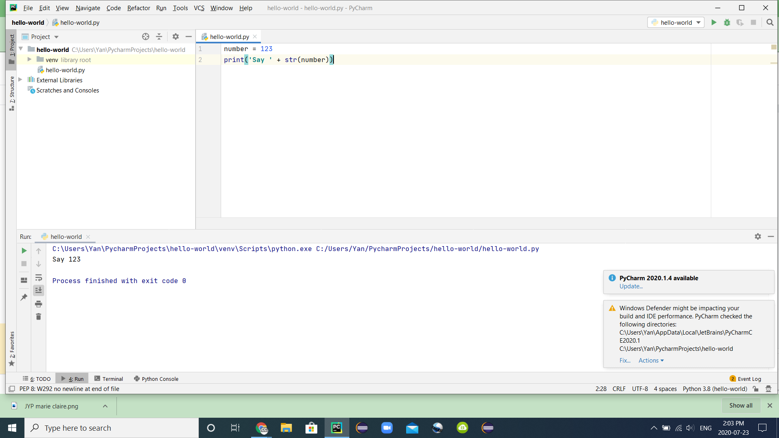
How to print different type variable/data:
Cast
number = 123
print('Say ' + str(number))

